Slide 1
Photo-Anime Translation based on Cycle-Consistent Adversarial Networks
Project of DD2424 Deep Learning in Data Science, Group 7
Yiming Hu Jia Fu Jiarui Tan
https://github.com/Mrstarr/CycleGAN-project

Slide 2
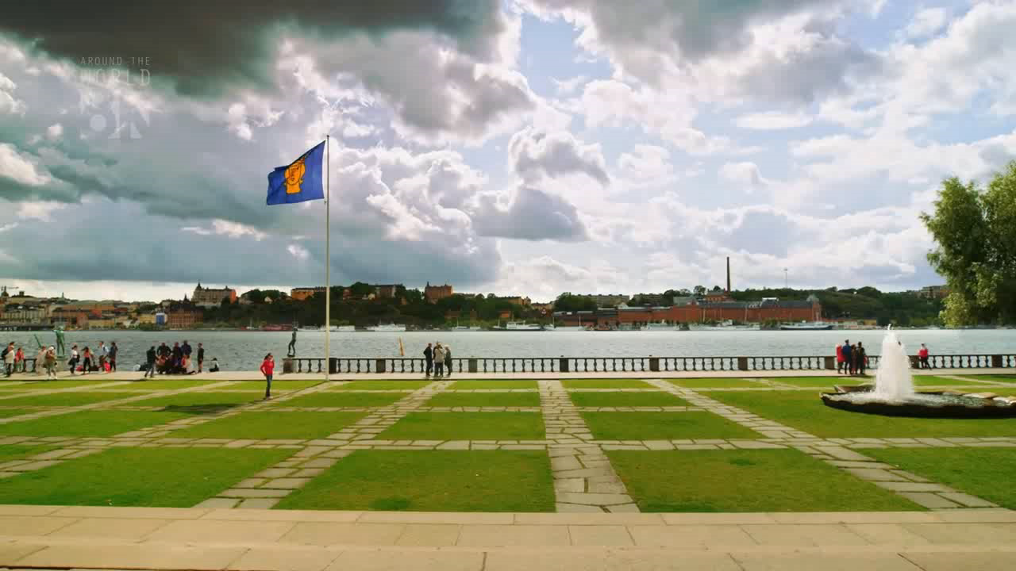
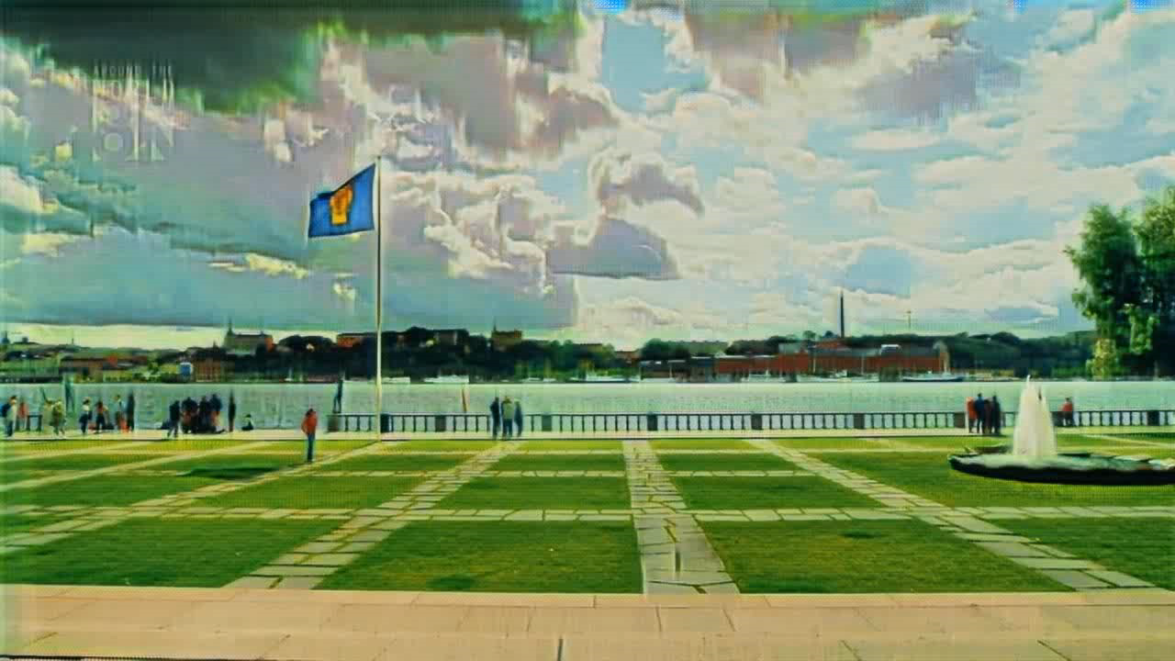

Slide 3



Slide 4
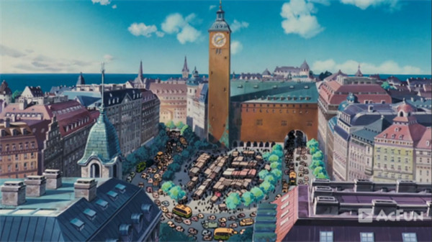
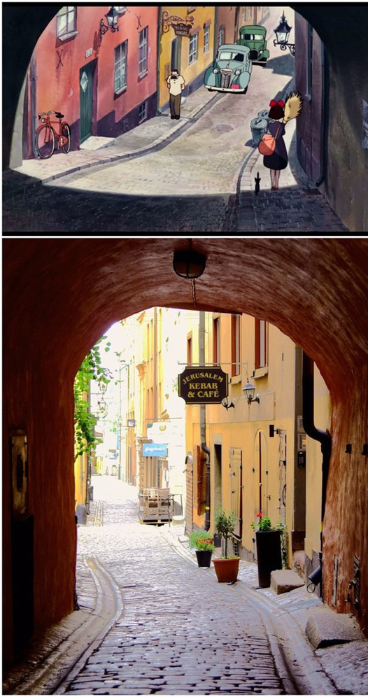
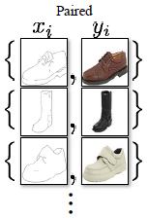
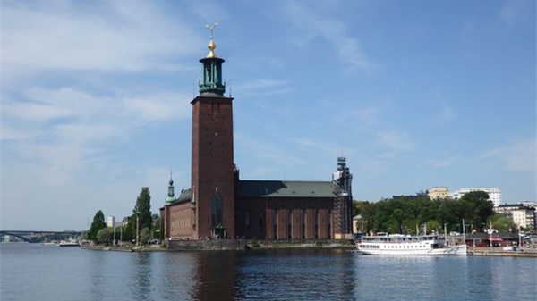
Introduction
Lack
Then, CycleGAN!

Slide 5




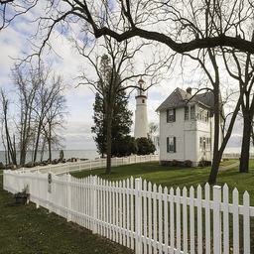
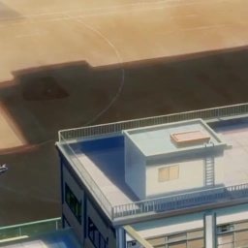

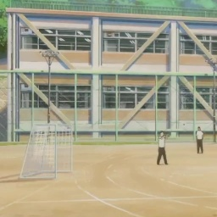
Data: Real2Anime2
trans.Compose([trans.RandomHorizontalFlip(),
trans.Resize((int(CONFIG.size_h * 1.12), int(CONFIG.size_w * 1.12)), Image.BICUBIC),
trans.RandomCrop((CONFIG.size_h, CONFIG.size_w)),
trans.ToTensor(),
trans.Normalize((0.5, 0.5, 0.5), (0.5, 0.5, 0.5))])

Slide 6
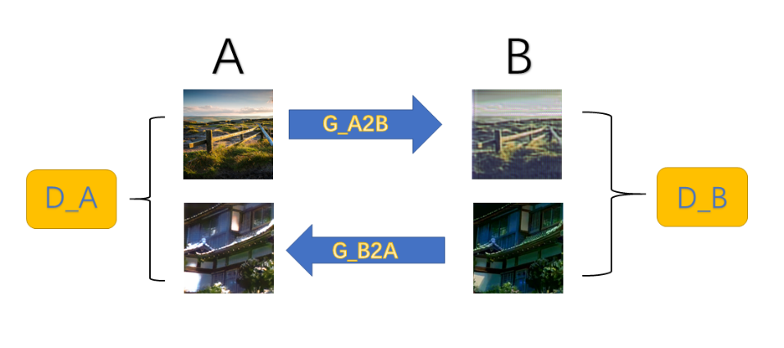
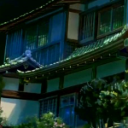
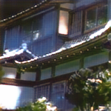
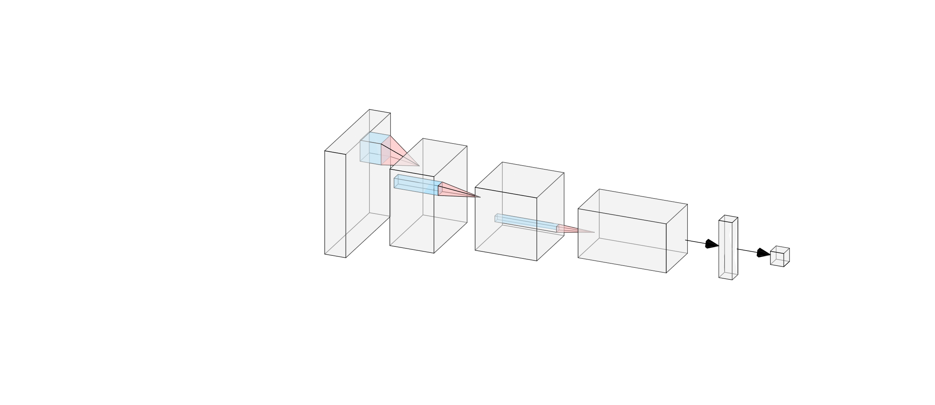
Network Architectures
Conv
ResNet
Transpose
Conv
“Encoder”
“Transformer”
“Decoder”
y=1

Slide 7
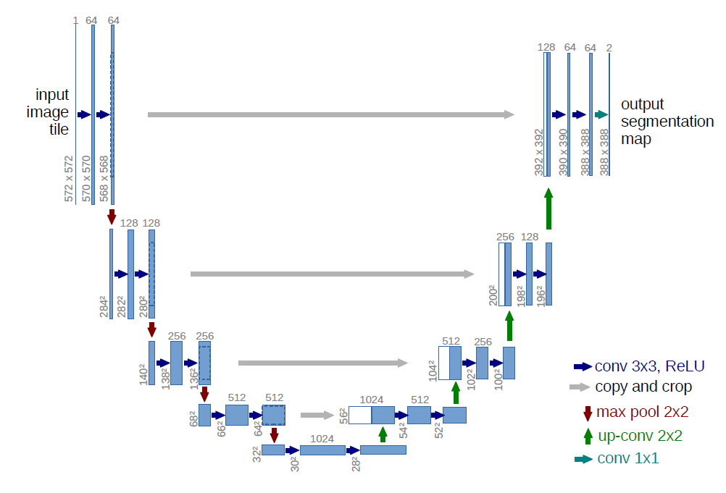
Network Architectures
U-Net

Slide 8
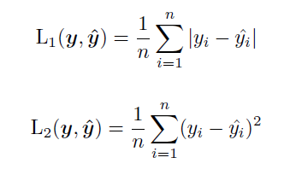
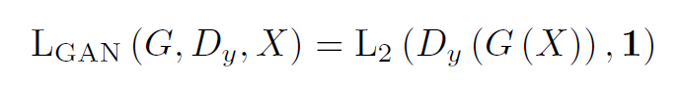
Loss Functions
Generator
Fake
?
Discriminator
Real
adversarial loss

Slide 9
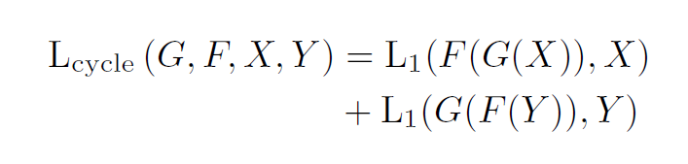
Loss Functions
Generator A→B
Generator
B→A
RealA
FakeB
FakeA
?
cycle consistency loss

Slide 10
Loss Functions
Generator A→B
RealB
FakeB
?
identity loss

Slide 11
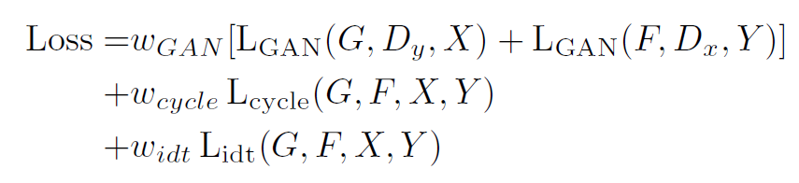
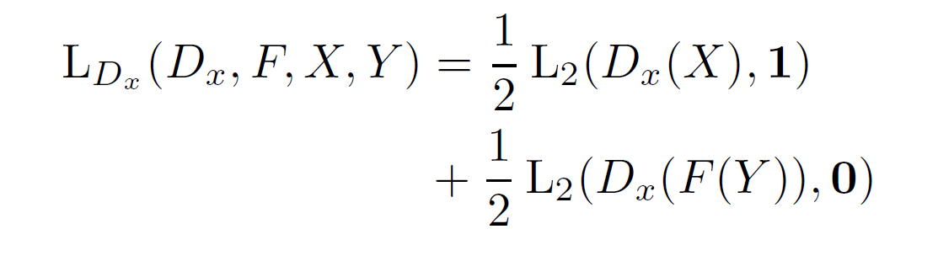
Loss Functions
Generator
Discriminator

Slide 12
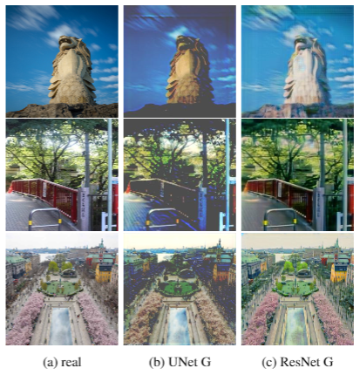
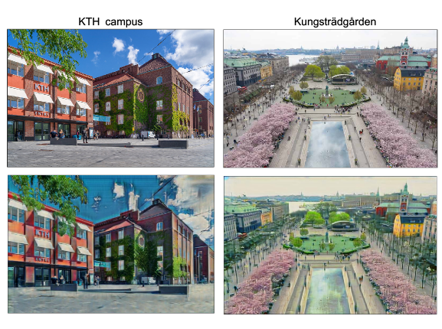
Experiments and Results

Slide 13
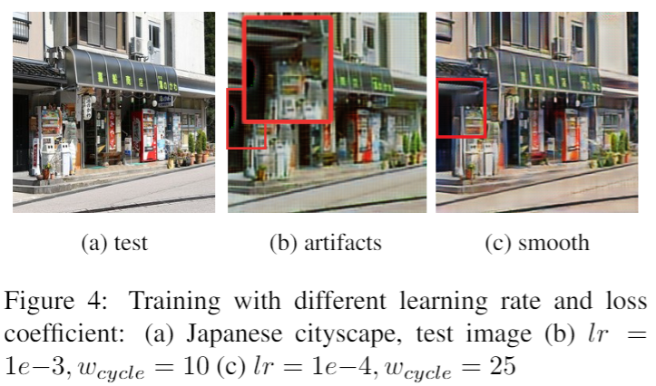
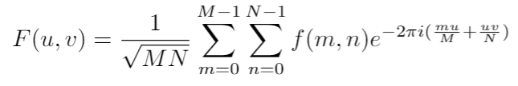
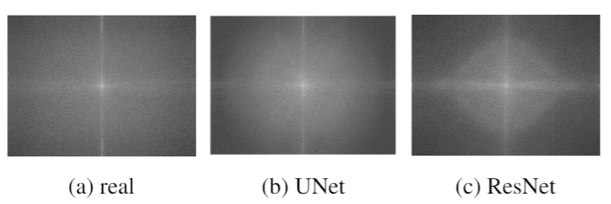
Training Stabilization and Fourier Analysis

Slide 14
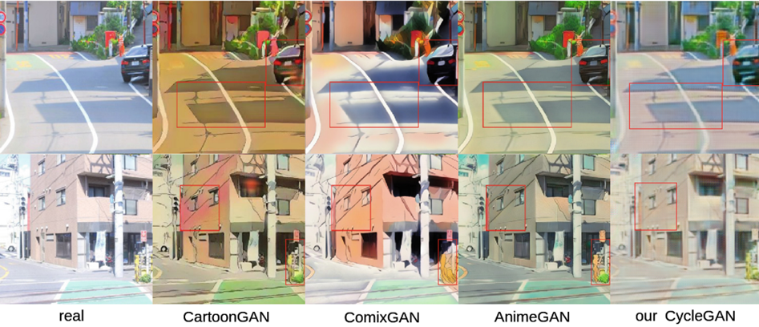
Comparison with latest works

Slide 15
Thank you!
https://github.com/Mrstarr/CycleGAN-project

